Slide 1


Slide 2
Voice controlled home automation

Slide 3
Problem Statement
Modern life demands efficiency and convenience in everyday tasks, especially in managing household chores and maintaining a comfortable living environment. Traditional methods of controlling home appliances and devices often require physical interaction, which can be inconvenient, time-consuming, and even pose challenges for individuals with limited mobility.
To address these limitations and enhance the overall living experience, a solution is needed that offers hands-free, voice-controlled automation of home appliances and devices

Slide 4
Literature review
SL. No | Title of the research paper | Author | Advantages | Limitations
1. | Voice Controlled home automation | Rejwan Bin Sulaiman | Enhanced Accessibility , User friendly interface , Flexibility with connectivity. | Security Concerns , Technical Dependency , Complexity in implementation.
2. | Design of smart home control system based on wireless voice sensor | Changchun Yang | Wireless Connectivity , Humanized control , Real time environment monitoring | Internet dependence , System cost ,Response speed .
3. | Voice Controlled home automation | P. Kiran Kumar, G. Joga Rao, Suguna K. Bhanu Prakash Kavya G, P. Venkata Srikar Srihari | Cost effective implementation , integration with google assistance , wireless connectivity. | Dependence on internet connectivity , voice recognition accuracy , Security concerns .

Slide 5

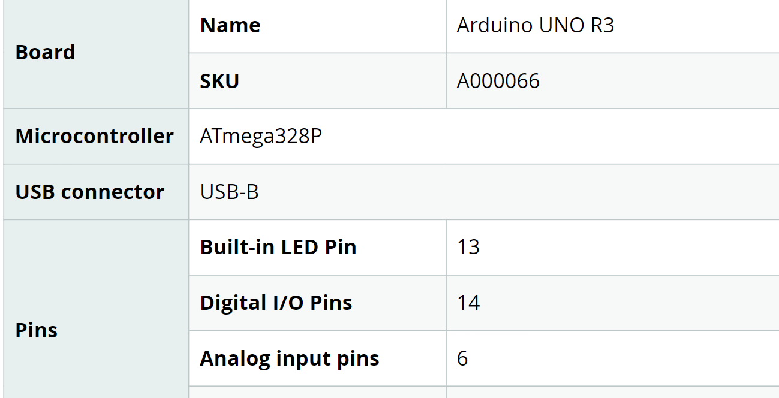
Components
Arduino UNO

Slide 6
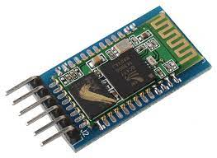
Bluetooth HC-05
Password | 1234 or 0000
Communication | Slave
Mode | Data Mode
Frequency | 2.4~2.524 GHz
Power Supply | 5VDC
Operating Current | 30mA
Range | <100m

Slide 7
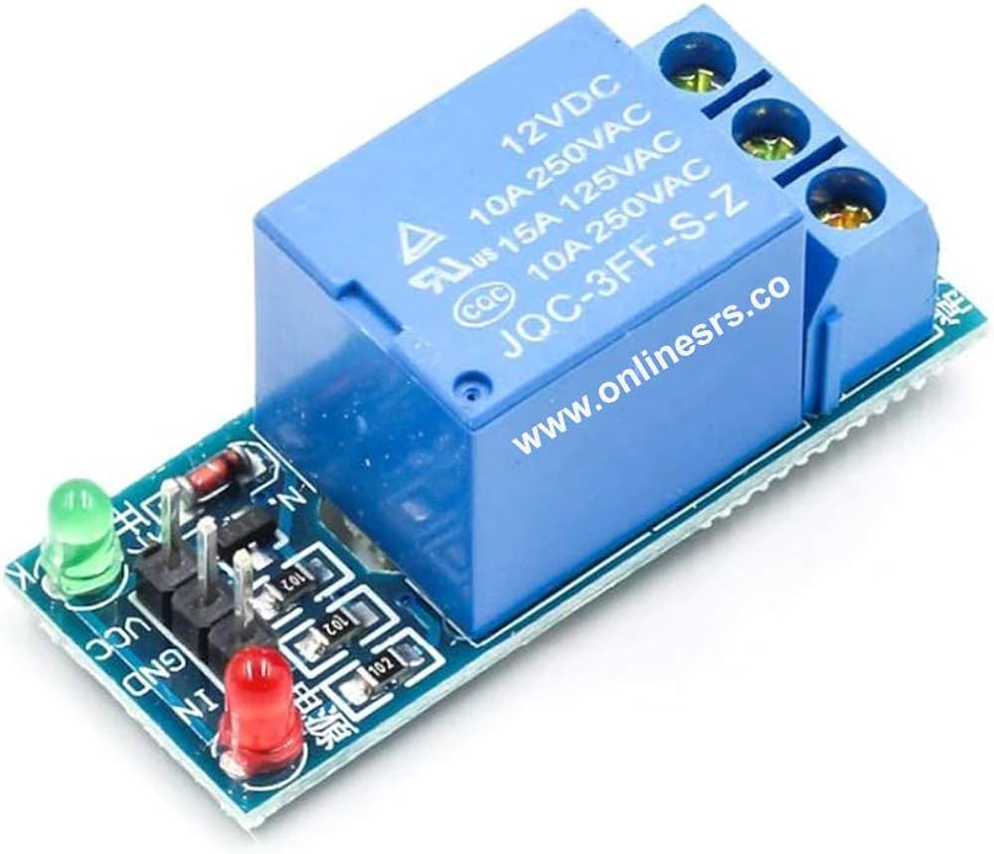
1 RELAY MODULE
Digital output controllable
Compatible with any 5V microcontroller such as Arduino.
Rated through-current: 10A (NO) 5A (NC)
Control signal: TTL level
switching voltage 250VAC/30VDC
switching current 10A
Size: 43mm x 17mm x 17mm

Slide 8
Block Diagram
Arduino Uno
Bluetooth
(HC-05)
2 Channel Relay Module
Bulb

Slide 9
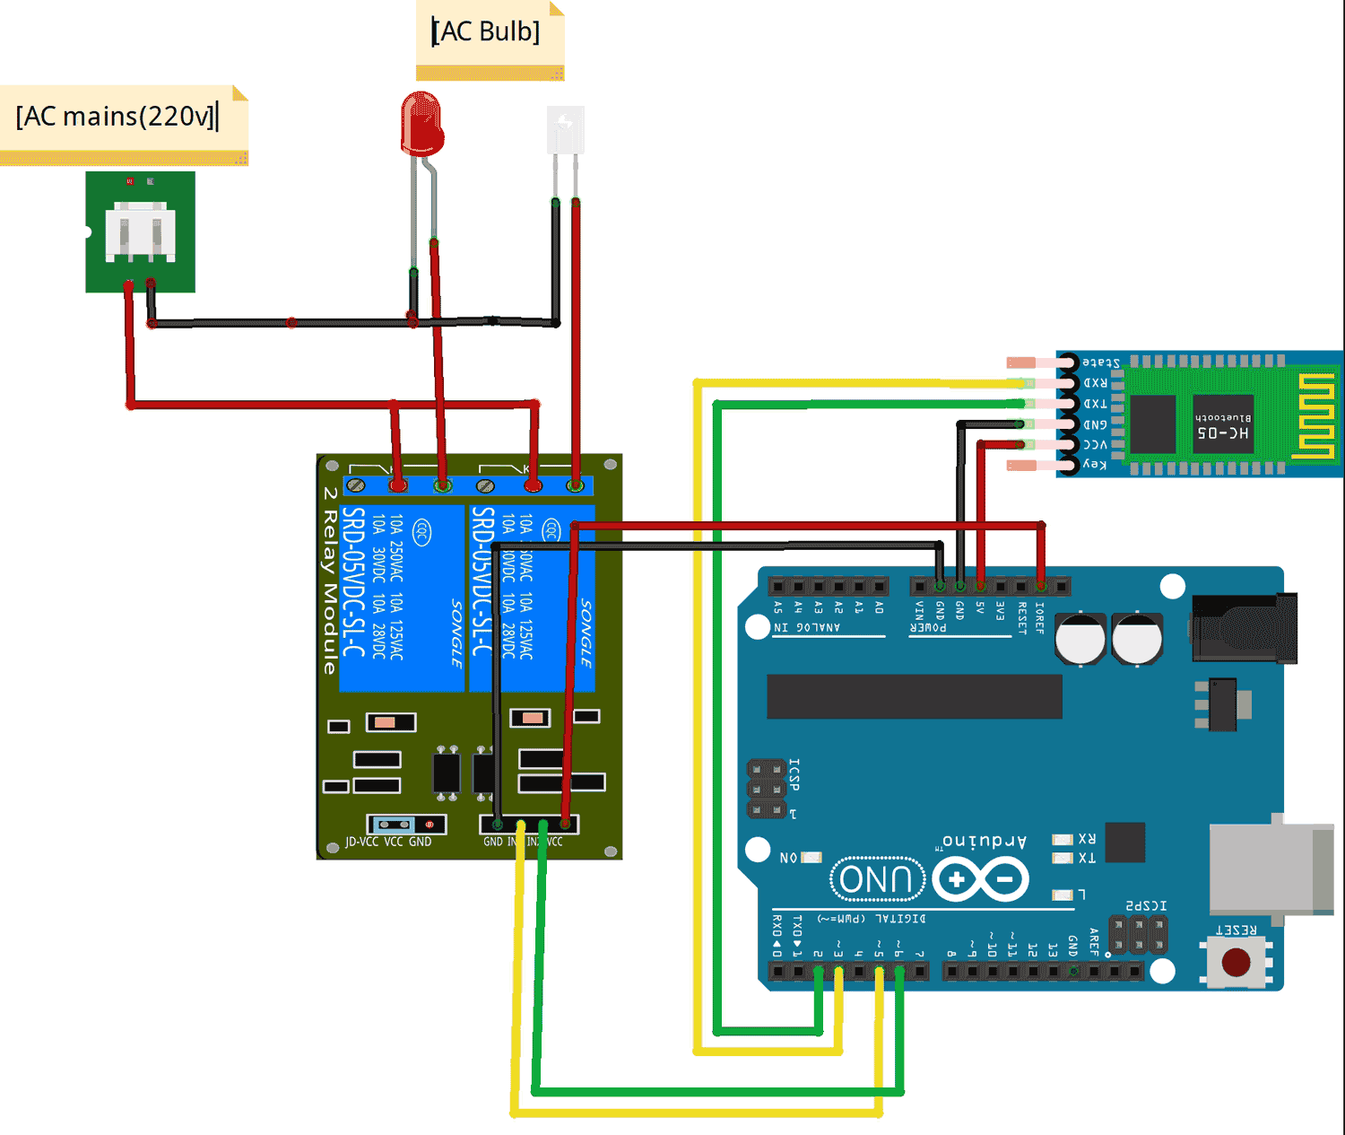
ARCHITECTURE
Adapter

Slide 10
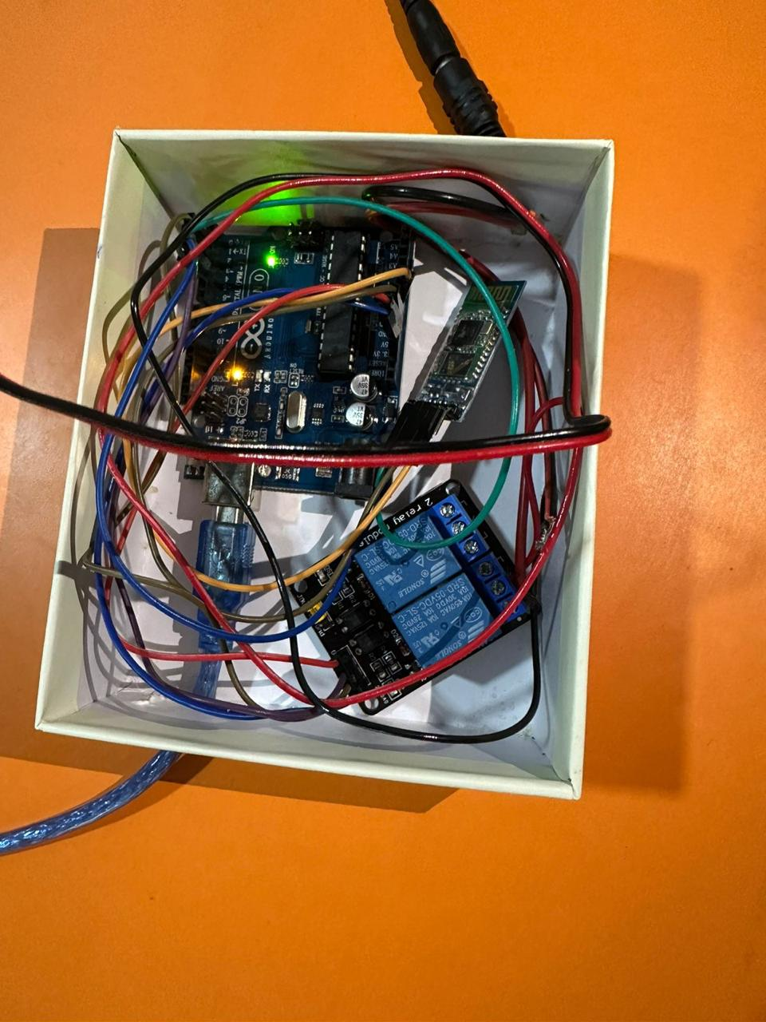
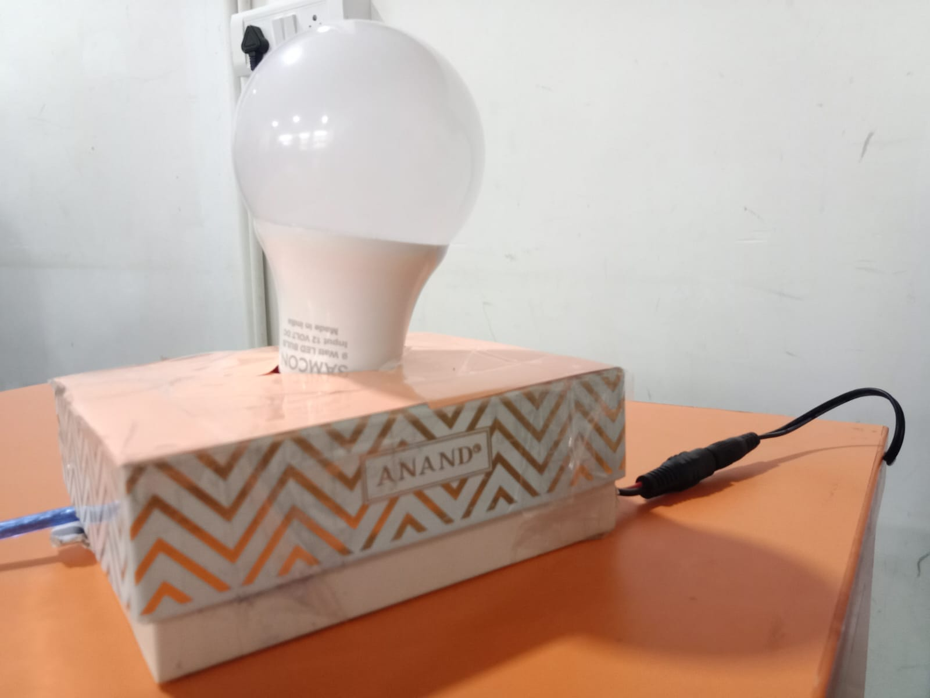
Prototype Model

Slide 11
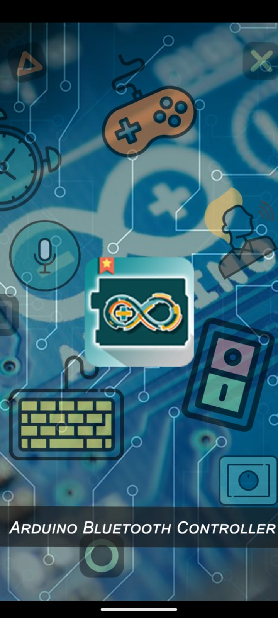
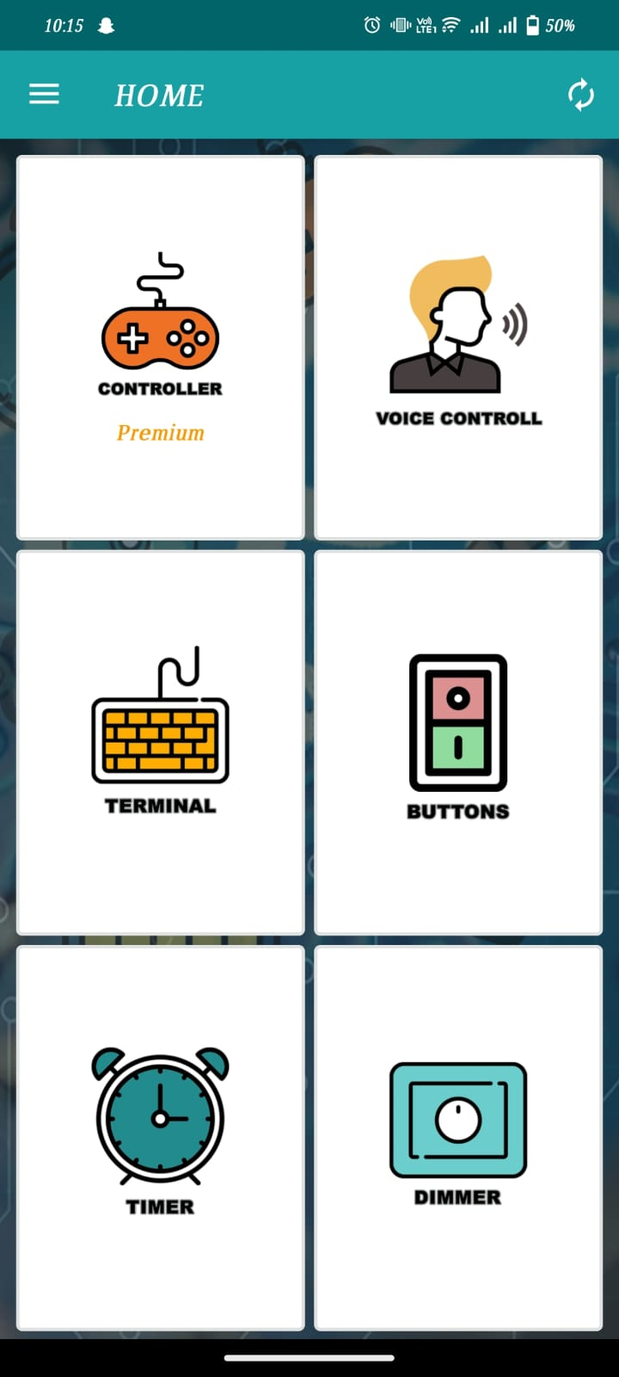
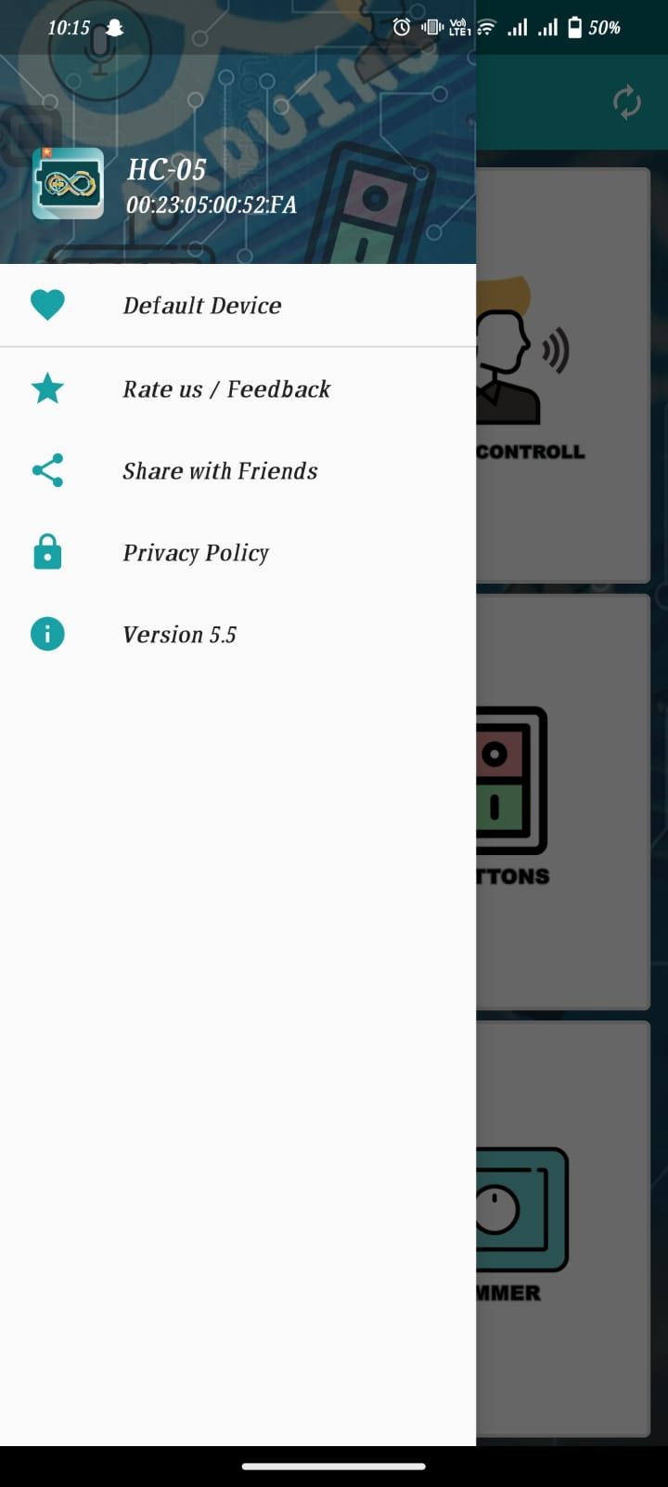
Application

Slide 12
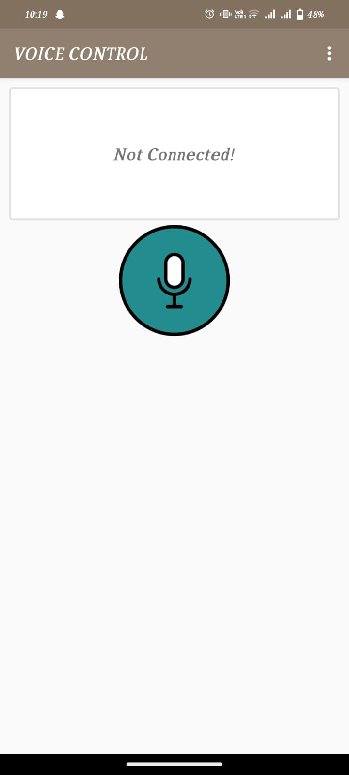
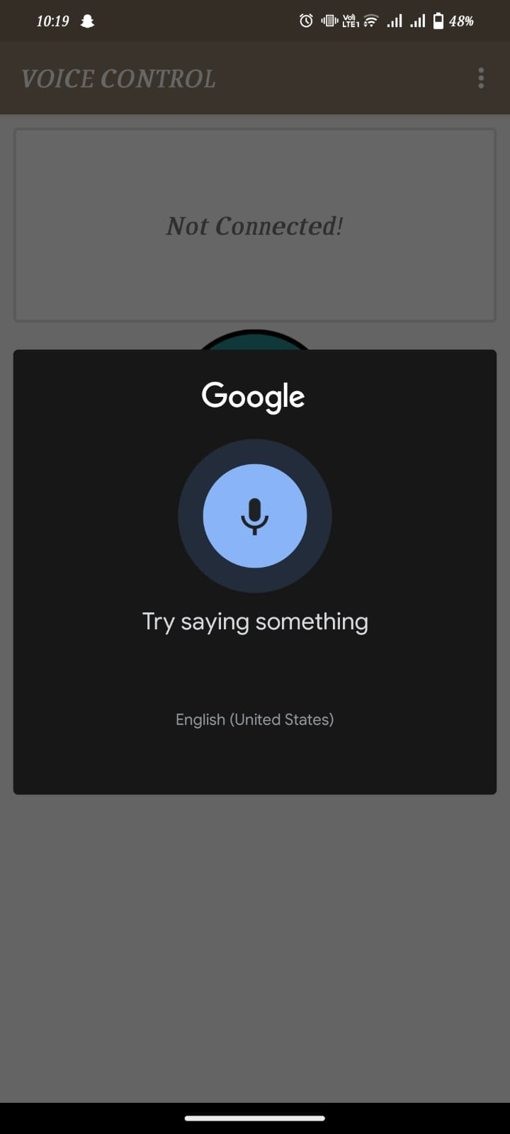

Slide 13
Source CODING
#include<SoftwareSerial.h>
// Define 2 channel relay pins
const int Light1 = 2; // Relay pin 1 (IN1)
const int Light2 = 3; // Relay pin 2 (IN2)
/* Create object named bt of the class SoftwareSerial */
SoftwareSerial bt(4, 5); /* (Rx,Tx) */
void setup() {
bt.begin(9600); /* Define baud rate for software serial communication */
Serial.begin(9600); /* Define baud rate for serial communication */
// Set Relay pins as OUTPUT
pinMode(Light1, OUTPUT);
pinMode(Light2, OUTPUT);
digitalWrite(Light1, HIGH);
digitalWrite(Light2, HIGH);
}

Slide 14
void loop() {
String data="";
char ch;
while (bt.available()) /* If data is available on serial port */
{ ch = bt.read(); /* Print character received on to the serial monitor */
data=data+ch;
}
Serial.print(data);
// Control the devices using voice command
if ((data == "turn on light one")||(data == "turn on light 1")) // turn on Device1
{
digitalWrite(Light1, LOW);
delay(200);
}

Slide 15
else if ((data == "turn off light one")||(data == "turn off light 1")) // turn off Device1
{
digitalWrite(Light1, HIGH);
delay(200);
}
// Control the devices using voice command
else if ((data == "turn on light two")||(data == "turn on light to")||(data == "turn on light 2")) // turn on Device2
{
digitalWrite(Light2, LOW);
delay(200);
}
else if ((data== "turn off light two")||(data == "turn off light to")||(data == "turn off light 2")) // turn off Device2
{
digitalWrite(Light2, HIGH);
delay(200);
}
}

Slide 16
Role of each Student
AKHILA PANKAN (20201CSE0852) – Coding, Circuit Making
VENNELA R (20201CSE0848) – Hardware Circuit Making, PPT
GINS BABU (20201CSE0860) – Hardware Circuit Making, PPT
SOFIYA KIRAN ANJUM (20201CSE0868)- Coding, Circuit Making

Slide 17
Thank you

